Slide 1
Atypon Presentation Template
User guidelines and tools for creating properly branded PowerPoint presentations
JUNE 2020
Questions? marketing@atypon.com

Slide 2
Branding guidelines for use with this template
Typography
All type should be Calibri regular, bold, or italic. No other typefaces should be used.
Titles are always black and bold.
Subtitles are always cobalt (dark blue) and bold.
Body text is always black.
Text can be sized as appropriate.
Bullets
Bullets are always solid and round.
Primary bullets are always warm red, sized at 100%.
Secondary bullets are gray em dashes.
Graphics, tables, and charts
Slides at the end of this deck contain resizable arrows, brackets, and flags for callouts that can be pasted into any slide, as well as sample tables and charts.
Layout
Headlines are always in the same position.
Text boxes can be moved as needed.
Illustrations
Make screenshots as large as possible. Put them on blank white slides. Use flags for captions.
Master pages
The master pages contain options for slide layouts not in the deck itself. Click on “Insert new slide” to see the full range of options.
Logos
Company and product logos, wordmarks, and lettermarks can be found on the last slide in this deck.
Template revised: July 1, 2020

Slide 3
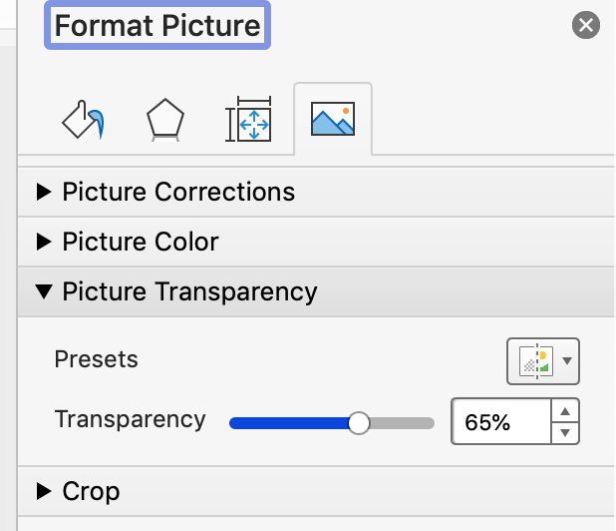
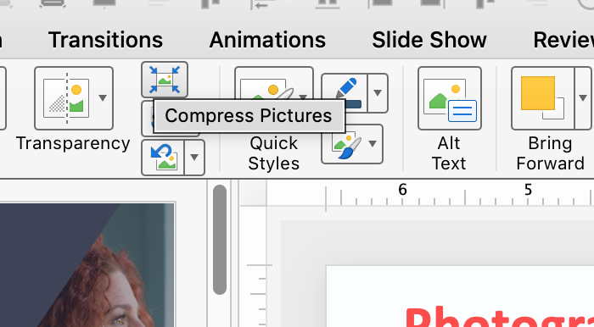
Photography
Photography
Photos are set at 65% transparency and should be used over a charcoal background. Do not use photos at 100% transparency. (See screenshots, right.)
See the Atypon Photo Archive for brand-approved photography. (Right-click on this link, then go to Hyperlink > Go to hyperlink.)
Contact Marketing for print-ready versions of any photos with watermarks.
Compressing photos to 220 dpi will minimize the file size. Double-click on any photo, then go to Picture Format in the toolbar and click on Compress Pictures. Select 220 dpi and “All Images in this File” (see screenshot, below).
Photography must represent diversity in race, gender, age, and STM occupation.

Slide 4
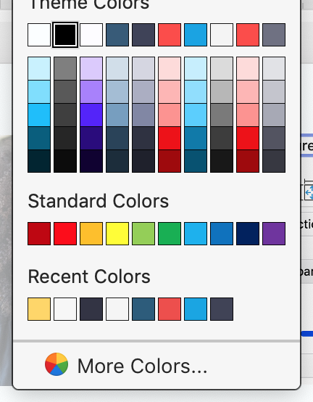
Colors
USE ONLY THESE >
Brand colors
Main colors: Black and cobalt.
Accent colors: Cyanide and red.
Sidebars are either charcoal (purple) or smoke (gray).
The brand colors are hard-coded into the top row of the color palette. Do not use any colors other than those in the top row of the palette.
MAIN COLORS
BLACK
CYANIDE

Slide 5
Title for Atypon’s PowerPoint Presentation Template
Name of Presenter
Title of Presenter
Date goes here

Slide 8
Agenda
Approved messaging.
Expand your reach.
Get discovered.
Connect with readers.
Accelerate product creation.
Understand your readers.
Convert visitors to customers.
Amplify your brand.

Slide 9
Divider slide

Slide 10
Divider slide

Slide 11
Divider slide

Slide 12
Our software. Your content, brand, and vision.
Approved messaging.

Slide 13
Our software. Your content, brand, and vision.
Approved messaging.

Slide 14
Atypon develops software that lets publishers manage, market, and monetize any type of content.
Approved messaging.

Slide 16
Title goes here
Header goes here
Bullet one
Bullet two
Bullet three
Sub bullet

Slide 17
Title goes here
Bullet one
Bullet two
Sub bullet
Bullet three

Slide 18
Slide with two subheads
Header Goes Here
Bullet one
Bullet two
Header Goes Here
Bullet one
Bullet two

Slide 19
Active Publishing
Approved messaging.
Active Publishing is a new strategy for online publishers
Shift the paradigm
Change your strategy
Engage your readers

Slide 20
Active Publishing
Approved messaging.
Active Publishing is a new strategy for online publishers
Shift the paradigm
Change your strategy
Engage your readers
This flag can be used as a sidebar to call out additional or important information.

Slide 21
Technology for publishing the world’s most important content
Approved messaging.
Expand your reach
Get discovered
Connect with readers
Accelerate product creation
Understand your readers
Convert visitors to customers
Amplify your brand

Slide 22
Title goes here/bold
Column one
This slide is for two columns
You can put main bullets
Main bullets with
Sub bullets
Column two
Second column bullet
Sub bullet for second column
You can add a line to separate the columns
Rule may be deleted.

Slide 23
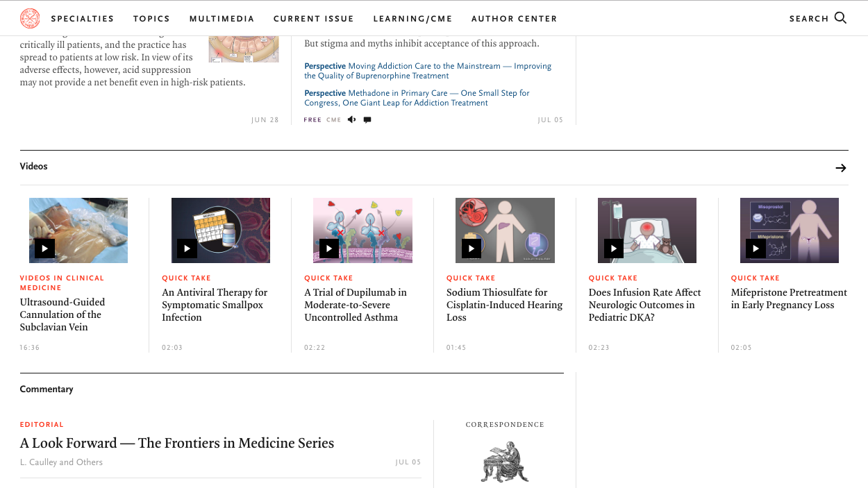
NOTE: Try to make maps or images full screen on a blank white background

Slide 24
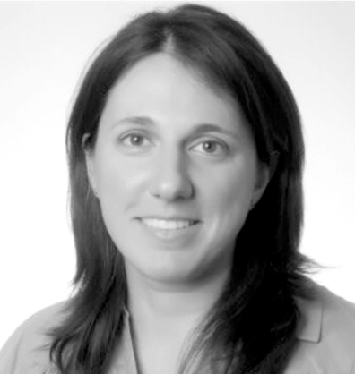
Meet the team. Staff headshots here.
(Right-click on link, then go to Hyperlink > Go to hyperlink.)
Rob Posadas VP Solution Architecture
Anna Charisi Solution Architect
Rashi Anand Program Manager
Dino Paravandis VP User Experience
Michael Markey VP Executive Account Management
Derek Young Manager of Client Services
Tania Hobson Senior Technical Account Manager
Costas Malatestas Director of Project Management
Ed Evans Solution Architect

Slide 25
Title goes here One or two lines
Option 1 See slide #2 for instructions on using photography.
Header can go here
Bullet one
Bullet two
Bullet three
Bullet four
Adjust placement according to how many bullets you have and sizing, if necessary.

Slide 26
Title goes here One or two lines
Option 2 See slide #2 for instructions on using photography.
Header can go here
Bullet one
Bullet two
Bullet three
Bullet four
Adjust placement according to how many bullets you have and sizing, if necessary.

Slide 27
Title goes here One or two lines
Option 3 See slide #2 for instructions on using photography.
Header can go here
Bullet one
Bullet two
Bullet three
Bullet four
Adjust placement according to how many bullets you have and sizing, if necessary.
Change pic to bridge in photho arvhice white image bridge

Slide 28
Platform
Approved messaging.
Site design & build
Content hosting & management
Identity & access management
Marketing & advertising
eCommerce
Key Themes in 2020
Automation and connected workflows to reduce cost and complexity
Providing a great on-site reading experience
Monetization opportunities for publishers
Support for reproducible science
Productizing AI-based capabilities

Slide 29
To copy and paste flags and text, select BOTH the text box and flag.
These flags should be used individually.
This is a sidebar that can be cut and pasted onto any slide.
This is a sidebar that can be cut and pasted onto any slide.
This is a sidebar that can be cut and pasted onto any slide.

Slide 30
Resizable arrows

Slide 31
Bracket elements

Slide 32
Table example
Current capabilities | Delivery in CY 2020 | Longer-term roadmap
Title Abstract Author names Author affiliations Match authors to affiliations Keywords listed in manuscript | Funding statement Funder entities Grant numbers Match grant numbers to authors Author email addresses Match email addresses to authors Corresponding author(s) Author country Improved Ringgold matching automation | Identification of previously submitted manuscript Data availability statement extraction Conflict of interest extraction Reference extraction and reformatting FundRef matching to extracted funder entities
To add or delete columns, right-click on the chart and choose either “insert” or “delete.”

Slide 33
Example pie chart
Pie charts are donut-shaped.
Donut hole should be set to 50%.
For help constructing charts, contact Marketing
Charts MUST be constructed using the embedded version of Excel. Go to Insert > Chart. Enter your dataor cut and paste it from an existing Excel file. The chart will generate automatically.
If using text above each pie chart as a header, delete bullets

Slide 34
Bar chart example
Charts MUST be constructed using the embedded version of Excel. Go to Insert > Chart. Enter your dataor cut and paste it from an existing Excel file. The chart will generate automatically.

Slide 35
Logos

Slide 36
Atypon.com
info@atypon.com
@atypon
_rev1 / 7.1.20

